Slide 1

"AI-Based Drug Recommendation System Using Pharmacy Records “
Presentation on
Presented By
Supervised By
Md.Riazul Hasan
Program: B.Sc. in CSE (HSC)
ID: 01921206025
Batch: 19th
Semester: 8th
Session: Spring - 2025
Mst. Sahela Rahman
Lecturer
Dept. of CSE, PUB
Department of Computer Science & Engineering
Pundra University of Science & Technology, Bogura – 5800

Slide 2
Outline
Introduction
Objectives
Literature Review
Problem Statement
Dataset
System Overview
Methodology
Result Analysis
Beneficiaries
Conclusion
Future Work
Refences

Slide 3
Introduction
"AI + Pharmacy Records = Faster & Accurate Disease Diagnosis"
Manual Diagnosis → Slow & Error-prone
AI-based Pharmacy Analysis → Fast & Data-driven
Better Patient Outcomes → Early Detection, Accurate Treatment

Slide 4
Objectives
Develop an ML-based model for drug recommendation using pharmacy records.
Identify patterns in frequently diagnosed diseases.
Ensure accurate and reliable medication prediction.
Support healthcare providers with data-driven decision-making.
Can be integrated into EHR or pharmacy management systems.

Slide 5
Literature Review (1/1)
Title | Limitations Identified | Does Our Work Solve This?
01.A Survey of Personalized Medicine Recommendation | Single-disease focus, lack of generalization, no feedback use | Yes – Our system supports multi-disease & feedback-aware models
02.AI-driven innovations in pharmaceuticals | Data bias, lack of interpretability, validation gap | Yes – Our approach emphasizes explainable AI and real-world integration
04.Comparison of pharmacy DB methods. | Low accuracy for non-integrated data sources | Yes – Our model handles real-time data across systems
05.ML & Prediction in Medicine (Beyond Hype) | Bias, outdated data, lack of causality | Yes – We plan to use real-time adaptive models and causal analysis

Slide 6
Problem Statement
Current medicine recommendation relies largely on manual processes and human judgment, which can cause errors, inefficiencies, and inconsistent drug suggestions. This issue matters because incorrect or delayed recommendations can harm patient health, increase risks of side effects, and strain healthcare systems. Automating this process with AI can improve accuracy, speed, and reliability, benefiting patients, doctors, pharmacists, and the overall healthcare community by ensuring better treatment decisions and outcomes.

Slide 7
Dataset
Name & Source :
Manually collected from a local retail pharmacy Size: Total 1,665
Number of Classes :
181 unique disease categories (balanced distribution)
Data Type & Format :
Structured CSV file ( Fields include Patient ID, Date, Symptoms, Disease, Medicines )
Relevance to Project :
Reflects real-world prescription behavior Supports medicine prediction based on symptoms/disease
Patient ID | Date | Symptoms | Disease | Medicines
0001 | 2024-04-12 | Pimples, oily skin | Acne | Benzoyl Peroxide, Clindamycin
0002 | 2024-04-15 | chest pain, shortness of breath | Angina | Nitroglycerin, Aspirin
0003 | 2024-05-12 | sneezing, runny nose, itchy eyes | Allergic Rhinitis | Loratadine, Fluticasone
0004 | 2024-08-20 | fever, rash, joint pain | Dengue | Acetaminophen, Hydration
Table 1.1: Overview of the raw dataset before preprocessing

Slide 8
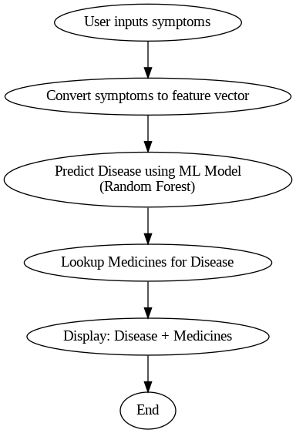
System Overview
User gives symptoms
Symptoms are converted to feature vectors
ML model predicts disease
Medicine is looked up
Disease + medicine is shown
Figure 1.1: Flowchart representing the overall system workflow from symptom input to medicine recommendation.

Slide 9
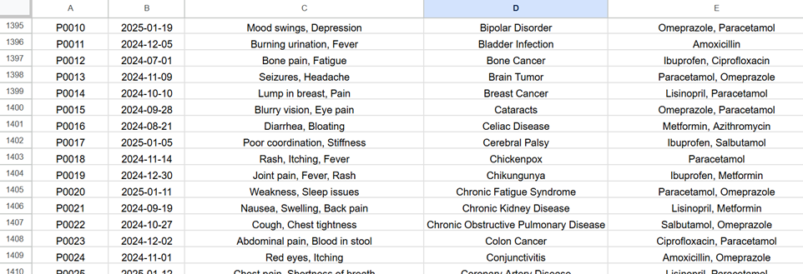
Methodology
Dataset: Collected pharmacy record dataset (raw + preprocessed)
Algorithms: Random Forest
Steps:
Data Cleaning
Feature Extraction
Model Training & Testing
Cross-validation used for performance check
Table 1.2: Overview of the dataset after preprocessing.

Slide 10
Result Analysis
Aspect | Details
Models Tested | Random Forest (Best Performer)
Accuracy | 91% (on train/test split)
Cross-Validation Score | 85% (using 5-fold cross-validation)
Best Model Reasoning | -Highest accuracy & recall - Handles noise well - Less overfitting
Cross-Validation Purpose | Ensure generalization Detect overfitting

Slide 11
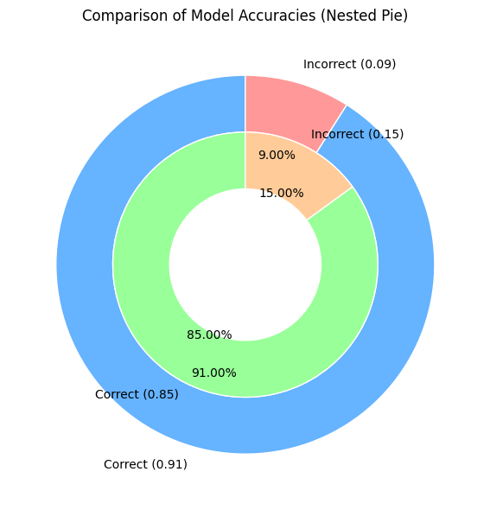
Result Analysis (contd..)
Test Accuracy: 91%
Cross-Validation (5-fold) Accuracy: 85%
The model shows strong performance in disease prediction.
5-fold CV ensures robustness and reduces overfitting risk.
Figure 1.2: Comparison of Model Accuracies

Slide 12
Beneficiaries
Patients
Faster, safer, and more accurate medication recommendations.
Doctors & Pharmacists
Reliable AI-based decision support and reduced workload.
Hospitals & Clinics
Streamlined workflows and improved treatment efficiency.
Healthcare Systems
Scalable automation and better data-driven resource management.

Slide 13
Conclusion
The system effectively automates drug recommendations with high accuracy, laying a strong foundation for future healthcare solutions integrating real-time data. While results are promising, further work is needed to improve scalability, test in clinical settings, and optimize performance. This project marks an important step toward AI-driven medical support that can enhance healthcare outcomes.

Slide 14
Future Work
Explore additional ML models like Random Forest and SVM to improve accuracy and robustness.
Enable real-time data input via web forms or APIs for instant recommendations.
Create a user-friendly web or mobile interface for healthcare professionals and patients.
Integrate with pharmacy databases for live updates and dynamic drug recommendations.

Slide 15
References
[1] Chen, J. H., & Asch, S. M. (2017). Machine learning and prediction in medicine — Beyond the peak of inflated expectations. New England Journal of Medicine, 376(26), 2507–2509. https://doi.org/10.1056/NEJMp1702071.
[2] A. Rajkomar, J. Dean, and I. Kohane, "Machine learning in medicine," New England Journal of Medicine, vol. 380, no. 14, pp. 1347–1358, 2019, doi: 10.1056/NEJMra1814259.
[3] H. Kaur and V. Kumari, "Predictive modelling and analytics for diabetes using a machine learning approach," Applied Computing and Informatics, vol. 18, no. 1, pp. 90–100, 2020, doi: 10.1016/j.aci.2019.12.003.
[4] E. Choi, A. Schuetz, W. F. Stewart, and J. Sun, "Using recurrent neural network models for early detection of heart failure onset," Journal of the American Medical Informatics Association, vol. 24, no. 2, pp. 361–370, 2016, doi: 10.1093/jamia/ocw112.

Slide 16
Thank You.
Any Questions?

